Slide 1
English 2 July 12
Max Keenan

Slide 2
schedule
Class times.
Afternoon today.
Reading periods = self study.

Slide 3
Attendance
What does it feel like to be successful? Use figurative language to describe the feeling.
EXAMPLE: Being successful feels like jumping into a freshley clean bed.

Slide 4
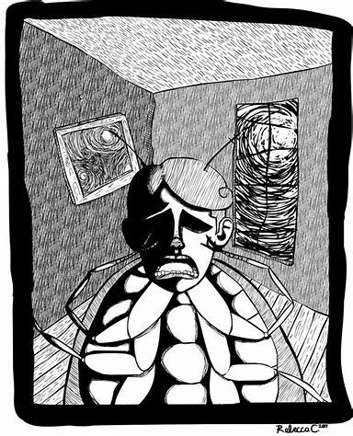

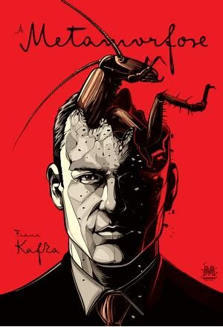
The metamorphasis

Slide 5
The metamorphasis
Journal 2
Is being alone a natural part of life? Answer the question, then explain why your answer is correct with an example from literature AND an example from your life.

Slide 6
The metamorphasis
Homework:
Vocabulary worksheet.
READ pages 137-151.

